Slide 1

HEART DISEASE PREDICTION AND REPORTING
Project supervisor : Mr.Murari Devakannan Kamalesh. M.E..,Ph.D
Name of the student : ALLAM SRI SAI RAM
Register Number : 40110069

Slide 2
Presentation Outline
Course Certificate
Introduction
Objectives
System Architecture
Ideation Map
Module Implementation
Application Snapshots
Results and Discussions
Conclusion & Future work
References

Slide 3
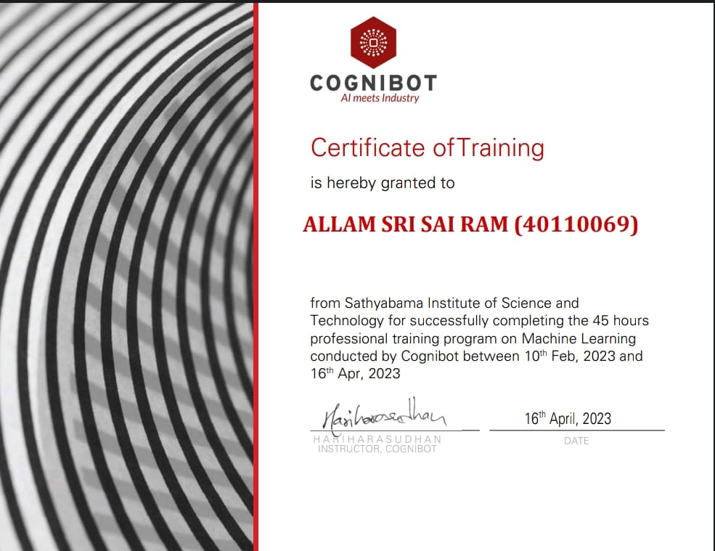
Course certificate

Slide 4
INTRODUCTION
Heart disease prediction application is developed using Python machine learning using logistic regression through Heart disease dataset from Kaggle.com.
Heart disease dataset is used to implement this application.
This project aims to predict future Heart Disease by analyzing data
of patients which classifies whether they have heart disease or not
using logistic regression.

Slide 5
OBJECTIVES OF THE PROJECT
The main objectives of developing this project are:
To develop machine learning model to predict future possibility of
heart disease by implementing Logistic Regression.
To determine significant risk factor based on medical dataset
which may leads to heart disease
To analyze feature selection methods and understand their
working principal.

Slide 6
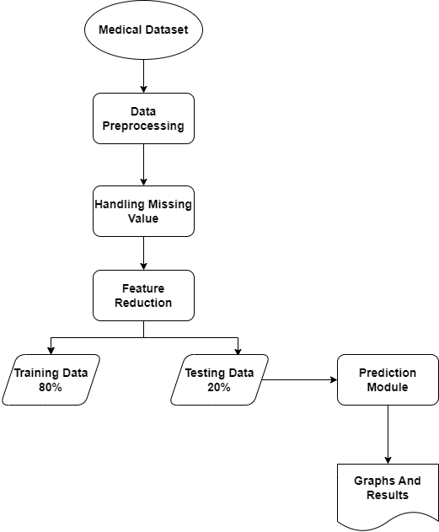
Architecture

Slide 7
Dataset used
Heart disease prediction dataset from Kaggle.com
https://www.kaggle.com/search?q=heart+disease+prediction
The dataset contains
Age/Sex
Chest pain types(4 values)
Resting blood pressure
Fasting blood sugar >120 mg/dl
Serum cholestoral in mg/dl
Maximum heart rate achieved

Slide 8
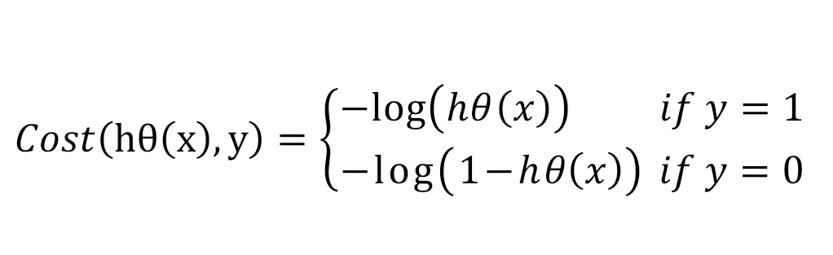
ALGORITHM USED
Logistic Regression
Logistic regression is a supervised classification algorithm.
It is a predictive analysis algorithm based on concept of probability.
It measures the relationship between the dependent variable
In logistic regression cost function is defined as

Slide 9
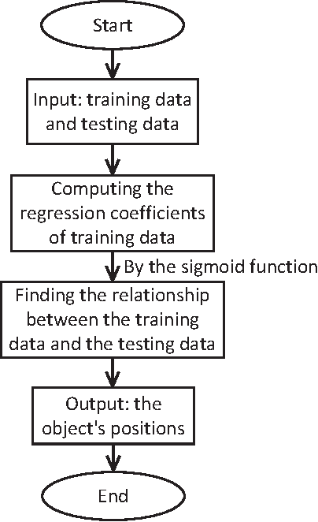
Algorithm Flowchart

Slide 10
Libraries used
NumPy
SciPy
Matplotlib
Statsmodels
Pandas
Seaborn
Flask
Sklearn

Slide 11
Project implementation
We have designed our project by using python programming language.
We collect data from heart disease prediction dataset from Kaggle.
Requirement of the project
Software : Python 3.10 , Jupyter notebook, Google
Hardware : PC or Desktop

Slide 12
Project Construction
For construction of successful heart disease prediction project we have to collect good data.
For our project we have collected our data source from Kaggle.com.
After collecting data set we have to imported it to Jupyter notebook with the help of pandas library.
After importing the data set using logistic regression divide the data set into training and testing part.

Slide 13
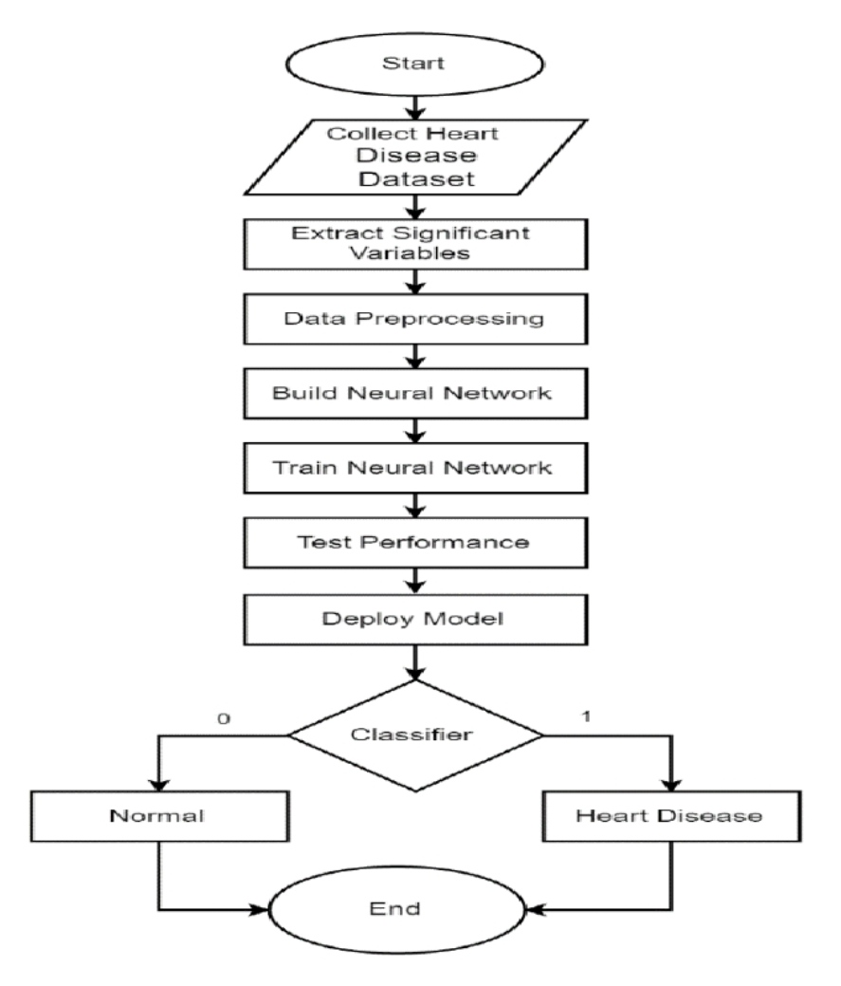
Project Flow chart

Slide 14
Methodology
Our project is carried out to achieve a set of goals with some conditions keeping in mind that it is easy to understand.
For easy understanding we have used simple machine learning modules in our project.
Pandas module have been used in our project for visualising the collected data .
NumPy module have been used to help of a large collection of high-level mathematical functions .
The algorithm used in this project is Logistic Regression
The project is implemented in python using jupyter notebook

Slide 15
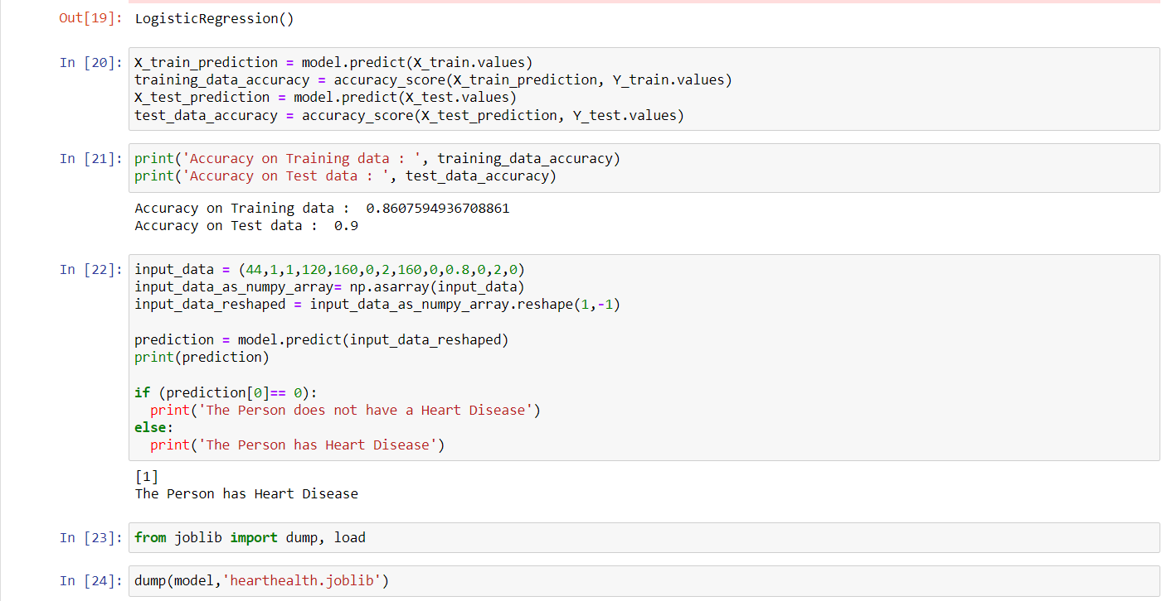
Application snapshots

Slide 16
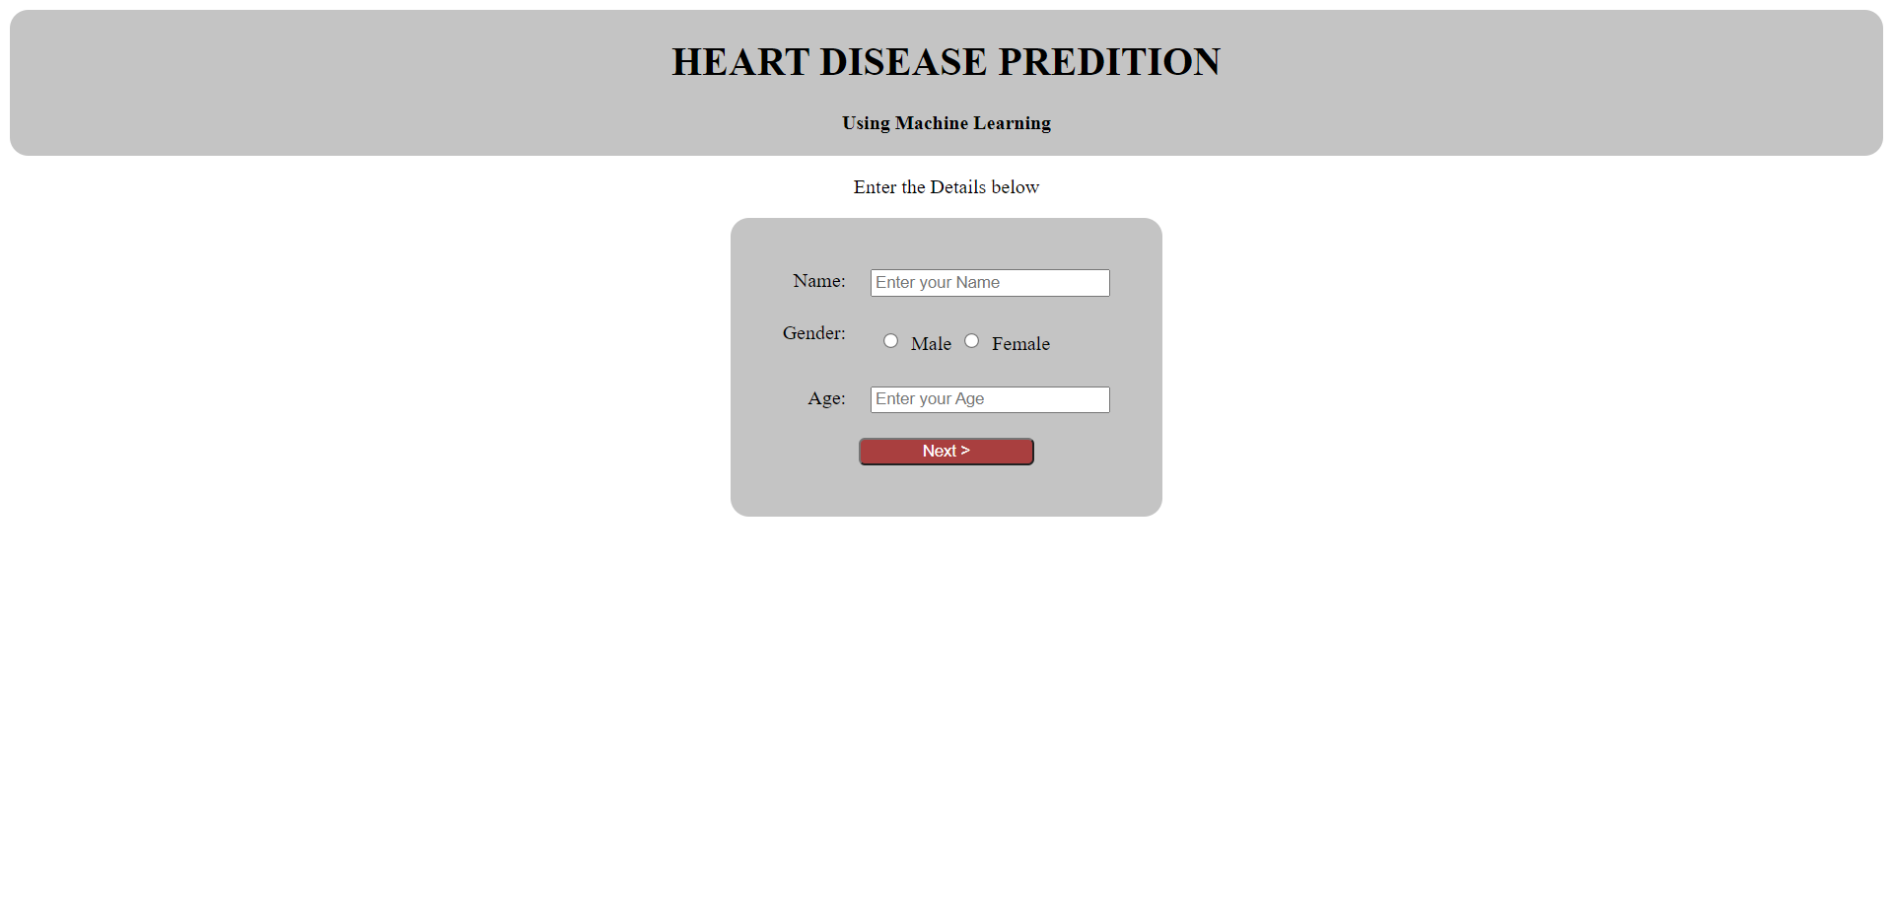
Application Output

Slide 17
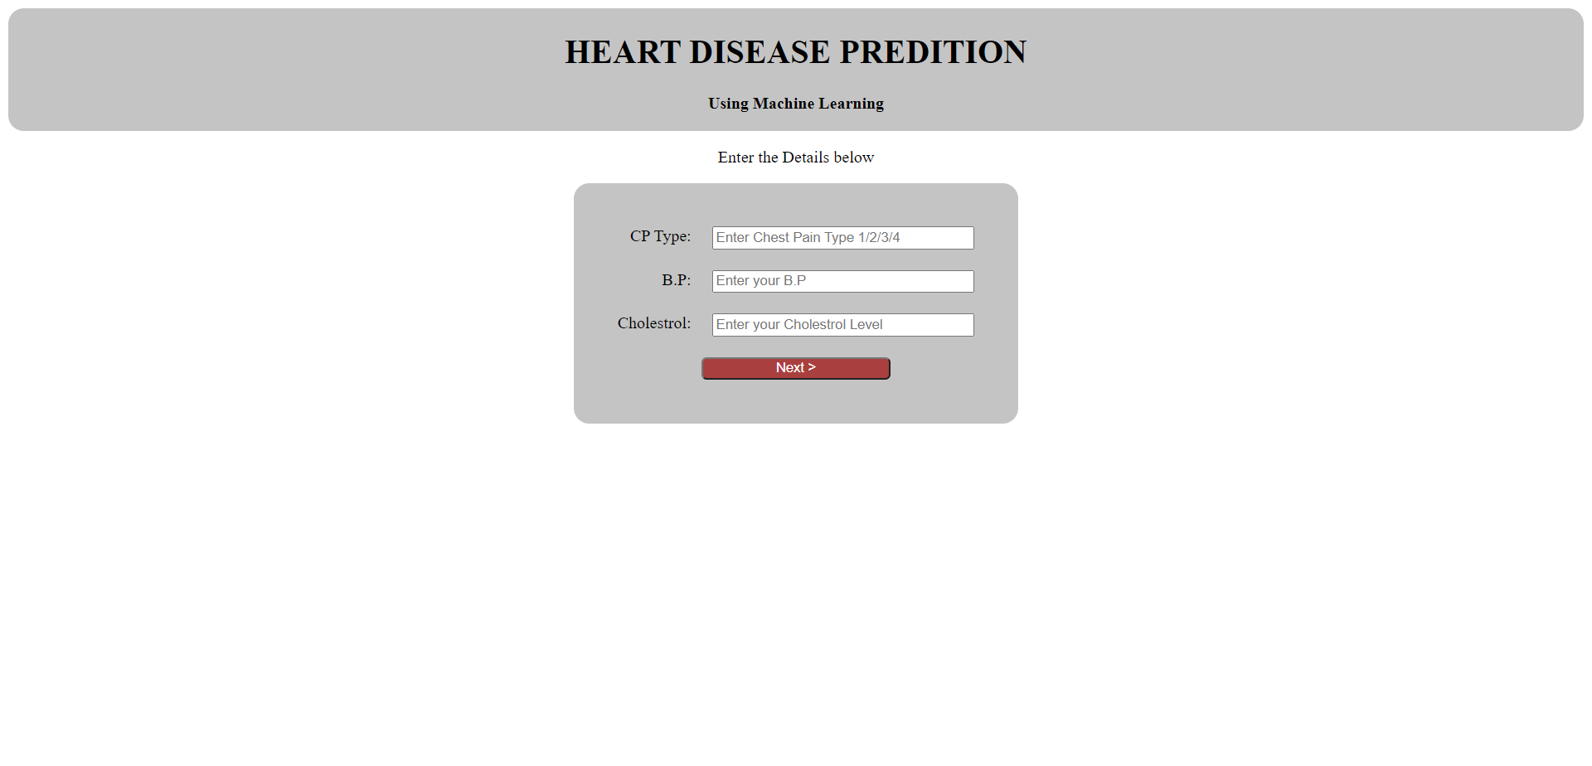
Index Snapshots

Slide 18
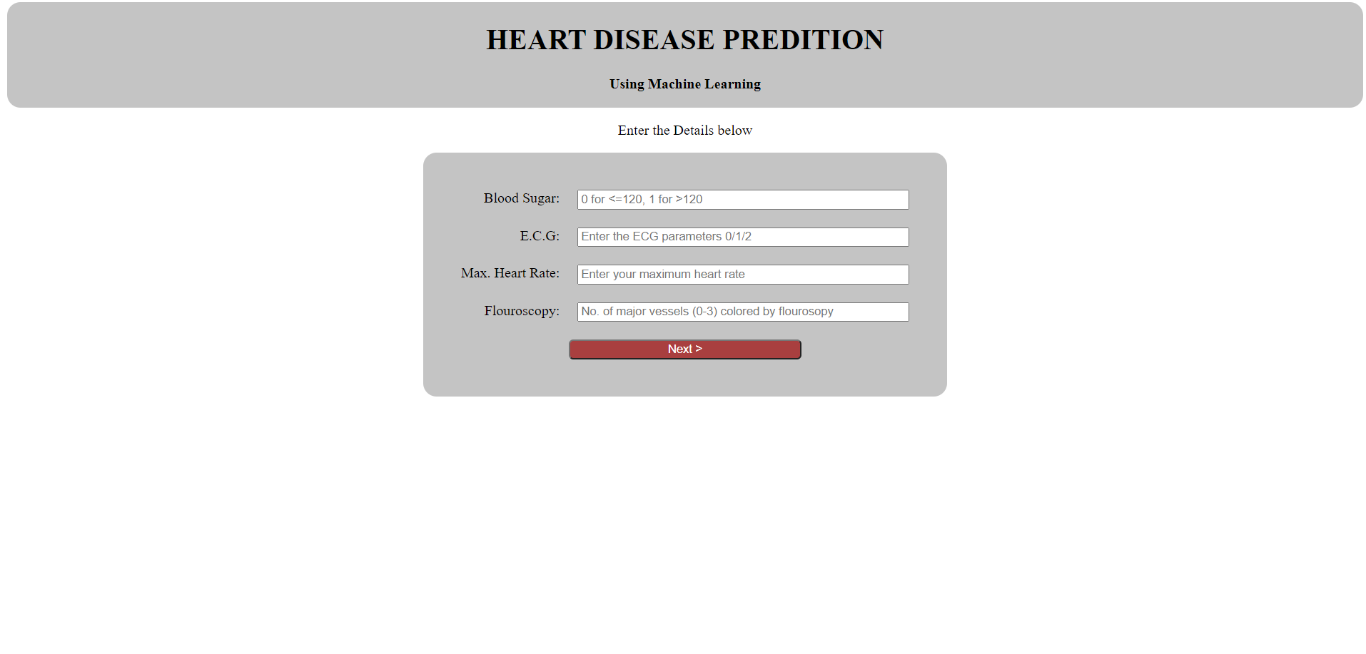
Index Snapshots

Slide 19
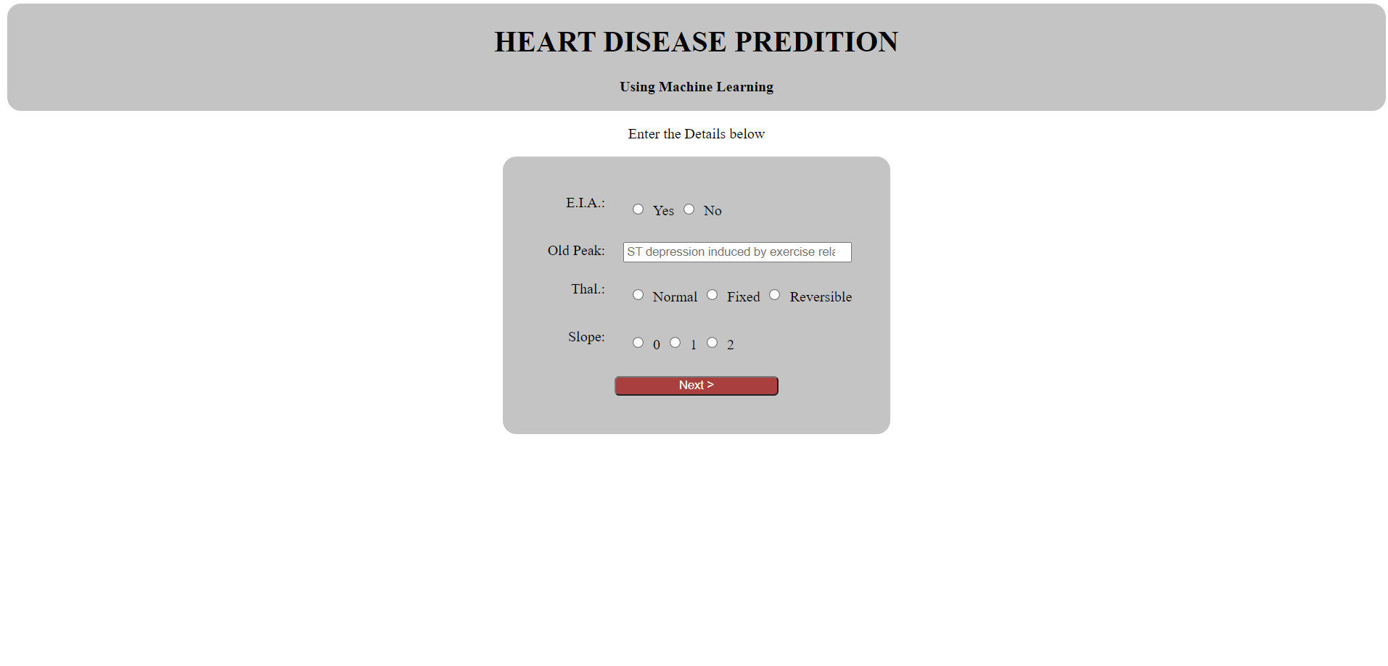
Index Snapshots

Slide 20
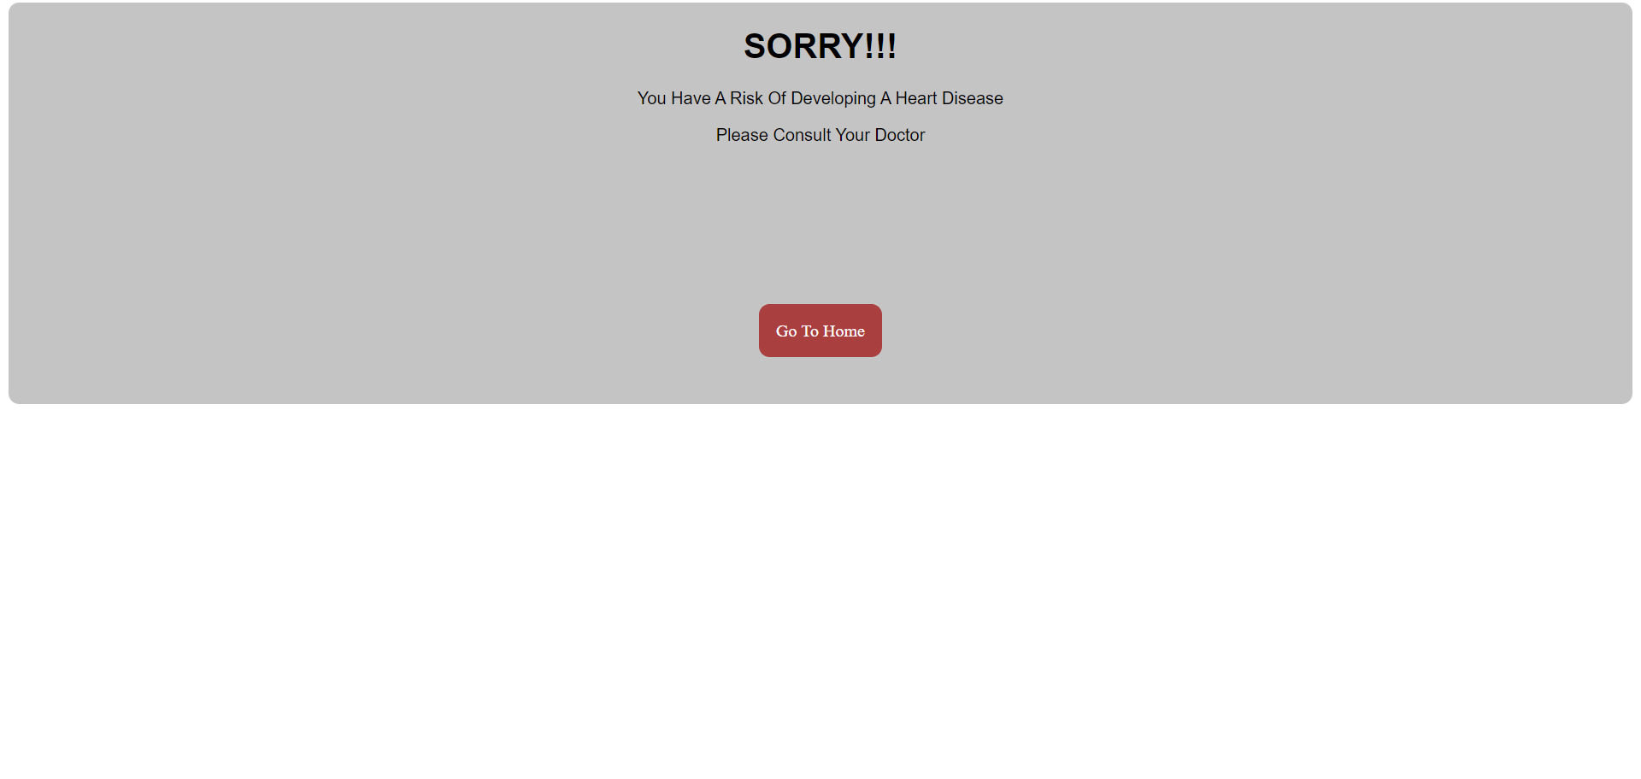
Failure snapshot

Slide 21
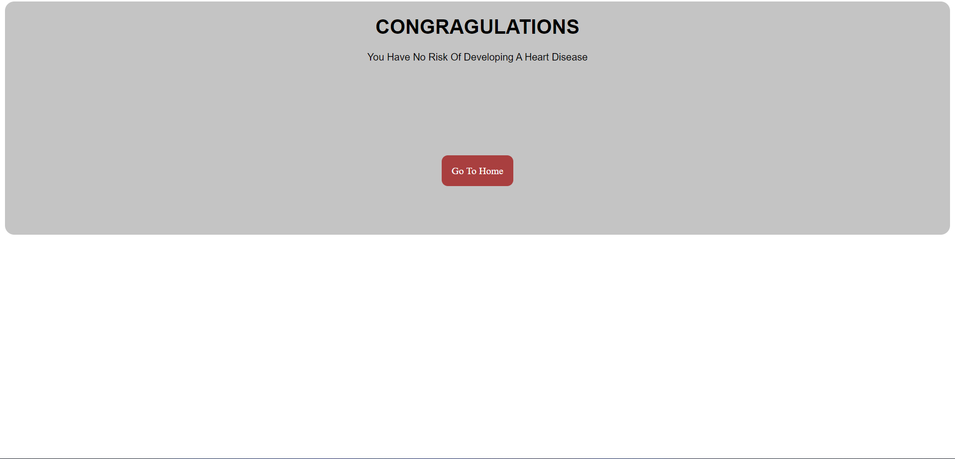
Success Snapshot

Slide 22
Code
The coding portion were carried out to prepare the data, visualize it,
pre-process it, building the model and then evaluating it.
The code has been written in python programming language using Jupyter notebook as IDE
The experiments and all the models building are done based on python libraries
The code is available in the Git repository given in following link
GitHub - Srisairam9881/heart-disease-prediction-using-machine-learning-PT-2

Slide 23
Result and Discussions
When performing various methods of feature selection testing it was found that backward elimination gave us the best results among other.
The various methods tried were backward elimination with and without Kfold, recursive feature elimination with cross validation.
The accuracy that was seen in them ranged around 86%

Slide 24
Conclusion
The early prognosis of cardiovascular disease can aid in making decisions on lifestyle changes in high risk patients and in turn reduce the complications, which can be great milestone in field of medicine.
This project resolved the feature selection i.e. backward elimination and RFECV behind the models and successfully predict the heart disease, with 86% accuracy.

Slide 25
The model used was logistic regression
Further for this enhancement, we can train on models and predict the types of cardiovascular disease providing recommendations to users, and also use more enhanced models.

Slide 26
References
https://www.kaggle.com/datasets/johnsmith88/heart-disease-dataset
https://simple.wikipedia.org/wiki/Heart_disease
https://en.wikipedia.org/wiki/Machine_learning
https://en.wikipedia.org/wiki/Logistic_regression

